Slide 1
MBA New Student Orientation
Academic Excellence
August 19, 2019

Slide 2
MBA Class of 2021
MBA New Student Orientation
ILD Takeaways
ILD and your MBA
Today’s agenda
Review of General information
Academics and Honor Code
Your ND MBA Experience

Slide 3
What is Student Services?
MBA New Student Orientation
General support & tools for leadership and career goals
Liaison to campus resources
Curriculum and classroom scheduling
Collaboration with faculty
Academic advising
“Interterm” & other experiential learning opportunities
International immersions
Graduate Business (MBA, MSA, MSM) student leadership, clubs, & committees
Graduate Business Commencement Ceremony
Notes:
Student services is your go to resource for all academic and student life questions

Slide 4
Quick Review/Questions
MBA New Student Orientation
ID cards and parking – access, purchasing, Transpo
Important places in Mendoza
Student Health and Wellbeing – UHS, UCC, McWell
Campus safety and security – 574-631-5555, ND Alert
Communication & Information – InsideND, find.nd.edu
Your Notre Dame experience
Fall semester - Schedules, books, core course waivers
Opportunities for Involvement – MBAA, Clubs/committees, case competitions, IDEA Center, others
Notes:
Student services is your go to resource for all academic and student life questions

Slide 5
MBA New Student Orientation
Questions?

Slide 6
Program Requirements
MBA New Student Orientation
Integral Leadership Development
64 credit hours (68 dual degree)
21 credits of core classes (41 core credits-dual degree)
One ethics elective and one communications elective
6 courses for concentration track
4 Interterm credits
General Electives
Complete at least one concentration track
Maintain 3.0 GPA
Notes:
Be an active participant
Ask more of each other – bring out the best in everyone
Part of what’s included in ILD – conflict management, trust, accountability

Slide 7
Concentration Tracks
MBA New Student Orientation
Not listed on diploma; on transcript only
Current tracks
Business Analytics
Business Leadership
Consulting/Strategy
Innovation and Entrepreneurship
Marketing
Corporate Finance
Investments
Supply Chain & Operations Management
Notes:
Be an active participant
Ask more of each other – bring out the best in everyone
Part of what’s included in ILD – conflict management, trust, accountability

Slide 8
“Interterm”
MBA New Student Orientation
Applied learning opportunity
Held week 8 of fall and spring semesters
Required in fall and spring (unless taking BOTFL or an International Immersion trip in spring)
1 credit hour
More information in early fall

Slide 9
“Interterm”
Year 2: Application
Impact
“Force for Good”
(Y2 Spring)
Apply
Or
Diversify/Broaden
(Y2 Fall)
Year 1: Foundation
Internship
Impact: Solidify MBA skillset by applying knowledge and skills for the good of an organization in need; capstone experience
Immerse
(Y1 Spring)
Apply: Fine tune skillset by applying knowledge and experience within chosen field and/or industry to reinforce strengths and build nuance
OR
Diversify/Broaden: Foundation well established, apply skillset into different field and context to round out learning, build up gaps, and broaden repertoire
Prepare
(Y1 Fall)
Prepare & Immerse: Bridge established knowledge – what you come in with – with new, growing body of knowledge

Slide 10
Your First Semester
MBA New Student Orientation
Focus on getting a good start
Two 7-week mods and “Interterm” week
Learning teams
Faculty may use teams for group work
Great support for studying and questions
Balanced approach for selection
Team expectations, goals, and conflict resolution strategy
Community of support and resources
Notes:
Be an active participant
Ask more of each other – bring out the best in everyone
Part of what’s included in ILD – conflict management, trust, accountability

Slide 11
Academic Advising
MBA New Student Orientation
Required advising sessions for Spring 2020 term
Begin in October
Sessions last up to 30 minutes
We’ll discuss…
Program requirements
Concentration track courses & electives outside track
Registration process and course selection
“Interterm” and international travel options
Selection of concentration track(s)
Notes:
Going to give addnl info about some of the electives and other opportunities available
Info sessions later this summer

Slide 12
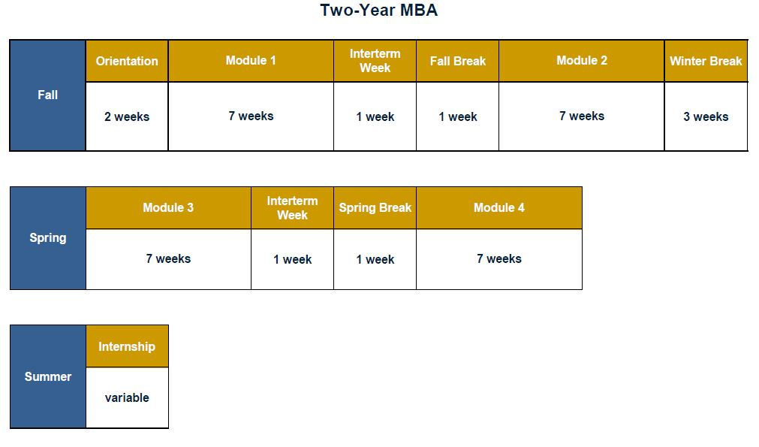
Academic Year
Notes:
Walked through differences between both programs
Core requirements – acct, fin, econ, stats

Slide 13
MBA New Student Orientation
Questions?

Slide 14
International Immersions
MBA New Student Orientation
March 2020: Interterm Week and Spring Break Week
2019 Options: China, Chile/Argentina, or South Africa (Beijing/Shanghai, Santiago/Buenos Aires, or Johannesburg/Cape Town)
$1,700* administrative fee
What is covered by administrative fee: hotel, intracontinental travel, some meals, and bus transfers
What is not covered: flights to/from countries, extra activities

Slide 15
Module 2: Santiago, Chile
MBA New Student Orientation
Full module in Santiago (7 weeks, late October – early December)
$1,000 administrative fee
Courses
International Marketing
International Finance
Latin American Economics
Spanish
Must have sufficient interest

Slide 16
2nd-year Application Courses
MBA New Student Orientation
Seed Investor Practicum
Shadow an investor for one week in Washington, DC, the week before 2020 spring semester and classes in Module 3
AIM - Applied Investment Management
Spring 2020 course for one-year and second-year MBA students
Live portfolio management ($10 million)
Information and application in fall 2019
Business on the Front Lines (BOTFL)
Spring 2020 course for one-year and second-year MBA students
Information and application in fall
BOTFL (short video)
Notes:
VC class changed for fall 2017 – used to be full term now 6 weeks?

Slide 17
Academic Calendar
MBA New Student Orientation
Important Dates to remember
Fall semester: August 26 – December 17
Module 1: August 26 – October 8
Study Day – October 9
Mod 1 Final Exams – October 10 &11 (Thursday & Friday)
Interterm: October 14 - 17
Fall Break: October 18 – 27
Module 2: October 28 – December 12
Study Day – December 13
Mod 2 Final Exams: December 16 & 17 (Monday & Tuesday)
Notes:
Going to give addnl info about some of the electives and other opportunities available
Info sessions later this summer

Slide 18
Academic Calendar
MBA New Student Orientation
Important Dates to remember (continued)
Spring semester: January 13 – May 5
Module 3: January 13 – February 25
Study Day – February 26
Mod 3 Final Exams – February 27 & 28 (Thursday & Friday)
Interterm: March 2 – 5
Spring Break: March 6 – March 15
Module 4: March 16 – April 29
Study Day – April 30 & May 1
Mod 4 Final Exams: May 4 & 5 (Monday & Tuesday)
Notes:
Going to give addnl info about some of the electives and other opportunities available
Info sessions later this summer

Slide 19
Attendance Expectations
MBA New Student Orientation
You are expected to be in class!
Beginning and ending of each mod/semester especially important
Plan travel accordingly
No early exams
Expected to complete all four days of interterm
Notes:
Going to give addnl info about some of the electives and other opportunities available
Info sessions later this summer

Slide 20
Academic Resources
MBA New Student Orientation
Academic Accommodations – Sara Bea Center
Scott Howland, Coordinator
MBA Math access – available for full year
LinkedIN Learning – free access
Center for Study of Languages & Culture
English and other languages tutoring/workshops/courses
Fanning Center for Business Communication

Slide 21
Mark Your Calendars
MBA New Student Orientation
Saturday, May 15, 2021 (tentative)
Friday rehearsals and other events
Graduation Requirements:
Minimum of 64 credits
Cumulative GPA of 3.0
One concentration
Maintain academic good standing throughout program

Slide 22
MBA New Student Orientation
Questions?

Slide 23
MBA New Student Orientation
Academic Integrity

Slide 24
GBP Academic Code
MBA New Student Orientation
Section 5.3.1 In Good Standing
“To maintain academic good standing, a business graduate student must achieve a cumulative G.P.A. of at least 3.000 in every semester.”
Section 5.4.2 Other Dismissals
“The University may dismiss any student whose health status or general conduct may be judged, in the sole discretion of the University, as clearly detrimental to the best interests of either the student or the University community. The University may also dismiss students for disciplinary reasons as set forth in du Lac: A Guide to Student Life at http://dulac.nd.edu, and for violations of the Mendoza College of Business Graduate Academic Code of Honor. Academic, financial, or other consequences depend upon the stipulated effective date of dismissal.”
Notes:
Complete document in packet and on GBP Portal. Please be sure to review in entirety.

Slide 25
Academic Integrity and Honor Code
MBA New Student Orientation
Why Is There an Honor Code?
Both students and faculty share in the responsibility for cultivating a learning environment
Honor Code Pledge
Every Notre Dame graduate business student is expected to make the ethical and moral commitment to act honestly and to not tolerate academic dishonesty on the part of other students

Slide 26
MBA New Student Orientation
In Your Own Work
All submitted work must be your own —no matter how small or insignificant the assignment, whether it is graded or ungraded, a draft or a final version
In Working with Other Students
Collaborative study that has been explicitly forbidden by your instructor is also forbidden by the Honor Code
Be mindful about sharing information, especially between groups or during a take home exam
What is Your Responsibility
Be sure to learn from each of your instructors how the Honor Code applies specifically to that course; clarify any questions you have about individual and group work
When in doubt--ASK

Slide 27
MBA New Student Orientation
Honor Code Violations
Plagiarism - Submitting without citation work that incorporates someone else’s ideas; for example:
Sentences copied from a book, article, essay, website, or newspaper, whether or not the material in question is copyrighted
Information copied from another student’s paper, notebook, or exam
Statements paraphrased from written or printed media material, including websites
Ideas lifted from books, essays, and websites
Cite all sources!

Slide 28
MBA New Student Orientation
Other Honor Code Violations
Giving or receiving unauthorized aid on an exam or quiz
Falsifying data of any kind
Giving a false reason for requesting a make-up examination, an extension on an assignment, or an excused absence
Turning in the same work for two or more courses without the explicit approval of all of the instructors involved
Failing to take responsible action upon witnessing or becoming aware of an Honor Code violation
Notes:
(multiple schools)

Slide 29
MBA New Student Orientation
IF YOU WITNESS AN HONOR CODE VIOLATION
If you witness a violation of the Honor Code or believe it has been violated, consider talking with the suspected student
If the student admits responsibility, urge the student to report him/herself to the instructor
If you are not comfortable confronting the student, you may choose to discuss the observed action(s) with the instructor, not naming those involved, and determine if the act merits action
Report the specific act of alleged academic dishonesty to the instructor

Slide 30
What would you do?
MBA New Student Orientation
Please discuss in groups the following situations

Slide 31
MBA New Student Orientation
What would you do?
Scenario #1
You are taking a final exam, which is being proctored by a member of the Student Services team because the professor is out of town. The professor gave instructions to the class that no cell phones or laptops should be used during the exam. You are sitting near the back of the classroom and notice that a classmate is using his cell phone. The Student Services proctor does not notice this. Is this an Honor Code violation? What do you do?
Notes:
What does it take to be authentic? To be true to your core values, especially in business, where some corporate cultures value quarterly earnings and shortcuts over long-term company growth and human concern for others?
Knowing does not always lead to doing.
Have high expectations in and out of the classroom
Starts with individual integrity

Slide 32
MBA New Student Orientation
What would you do?
Scenario #2
You are watching a team of classmates give a final presentation for a finance class. On one of the slides presented, you notice that a data chart matches one you have seen on the internet. However, no citation or reference is made about the data chart, either verbally or on the slide. Is this an Honor Code violation? What do you do?
Notes:
What does it take to be authentic? To be true to your core values, especially in business, where some corporate cultures value quarterly earnings and shortcuts over long-term company growth and human concern for others?
Knowing does not always lead to doing.
Have high expectations in and out of the classroom
Starts with individual integrity

Slide 33
MBA New Student Orientation
What would you do?
Scenario #3
A business analytics course has two sections on Mondays and Wednesdays: one at 8:00 a.m. and one at 10:00 a.m. You are registered in the 8:00 a.m. section and have just completed the midterm exam. Leaving the classroom, you overhear a classmate from the 8:00 a.m. section sharing details of the exam with a classmate in the 10:00 a.m. section. Is this an Honor Code violation? What do you do?
Notes:
What does it take to be authentic? To be true to your core values, especially in business, where some corporate cultures value quarterly earnings and shortcuts over long-term company growth and human concern for others?
Knowing does not always lead to doing.
Have high expectations in and out of the classroom
Starts with individual integrity

Slide 34
MBA New Student Orientation
What would you do?
Scenario #4
You and a classmate—who is also a good friend—are both taking an ethics elective together. The classmate has asked to take the course’s final exam a day early and the professor has granted this exception. You later learn that the real reason for the request is so that the student can attend a concert out of town on the day of the exam, but this was not the reason given to the professor. Is this an honor code violation?
What do you do?
Notes:
What does it take to be authentic? To be true to your core values, especially in business, where some corporate cultures value quarterly earnings and shortcuts over long-term company growth and human concern for others?
Knowing does not always lead to doing.
Have high expectations in and out of the classroom
Starts with individual integrity

Slide 35
MBA New Student Orientation
Is this an Honor Code violation? What do you do?
Scenario #1
You are taking a final exam, which is being proctored by a member of the Student Services team because the professor is out of town. The professor gave instructions to the class that no cell phones or laptops should be used during the exam. You are sitting near the back of the classroom and notice that a classmate is using his cell phone. The Student Services proctor does not notice this.
Scenario #2
You are watching a team of classmates give a final presentation for a finance class. On one of the slides presented, you notice that a data chart matches one you have seen on the internet. However, no citation or reference is made about the data chart, either verbally or on the slide.
Scenario #3
A business analytics course has two sections on Mondays and Wednesdays: one at 8:00 a.m. and one at 10:00 a.m. You are registered in the 8:00 a.m. section and have just completed the midterm exam. Leaving the classroom, you overhear a classmate from the 8:00 a.m. section sharing details of the exam with a classmate in the 10:00 a.m. section.
Scenario #4
You and a classmate—who is also a good friend—are both taking an ethics elective together. The classmate has asked to take the course’s final exam a day early and the professor has granted this exception. You later learn that the real reason for the request is so that the student can attend a concert out of town on the day of the exam, but this was not the reason given to the professor.
Notes:
What does it take to be authentic? To be true to your core values, especially in business, where some corporate cultures value quarterly earnings and shortcuts over long-term company growth and human concern for others?
Knowing does not always lead to doing.
Have high expectations in and out of the classroom
Starts with individual integrity

Slide 36
MBA New Student Orientation
Honor Code Pledge
The Graduate Business Honor Code Pledge
“The MCOB graduate business students, united in a spirit of mutual trust and fellowship, mindful of the values of a true education and the challenge posed by the world, agree to accept the responsibilities for honorable conduct in all academic activities, to assist one another in maintaining and promoting personal integrity, and to abide by the principles and procedures in this Honor Code.”

Slide 37
MBA New Student Orientation
Questions?

Slide 38
Summary
MBA New Student Orientation
Many academic options and opportunities
Begin defining your ND experience – what are top priorities for this year
Academics, Leadership, Extra-curricular
Understand Academic Calendar
Review Academic and Honor Codes in entirety
Utilize GBP Student Services Portal and InsideND
Build your personal brand and PRACTICE skills
Others here to assist – ASK & stay curious

Slide 39
MBA New Student Orientation
Upcoming Events
ILD Survey
Orientation Survey – end of week
Workshops – begin tomorrow
University Opening Mass & Picnic – Tues., August 27
Graduate Business Club Fair – Tuesday, September 3
MBA Class Meeting – Wednesday, September 18
Graduate Business Fall Social – Thursday, September 19

Slide 40
MBA New Student Orientation
Questions?

